Slide 1
The Data Link Layer
Our goals:
understand principles behind data link layer services:
  error detection, correction
  sharing a broadcast channel: multiple access
  link layer addressing
  reliable data transfer, flow control: done!
instantiation and implementation of various link layer technologies
Overview:
link layer services
error detection, correction
multiple access protocols and LANs
link layer addressing, ARP
specific link layer technologies:
  Ethernet
  hubs, bridges, switches
  IEEE 802.11 LANs
  PPP
  ATM

Slide 2
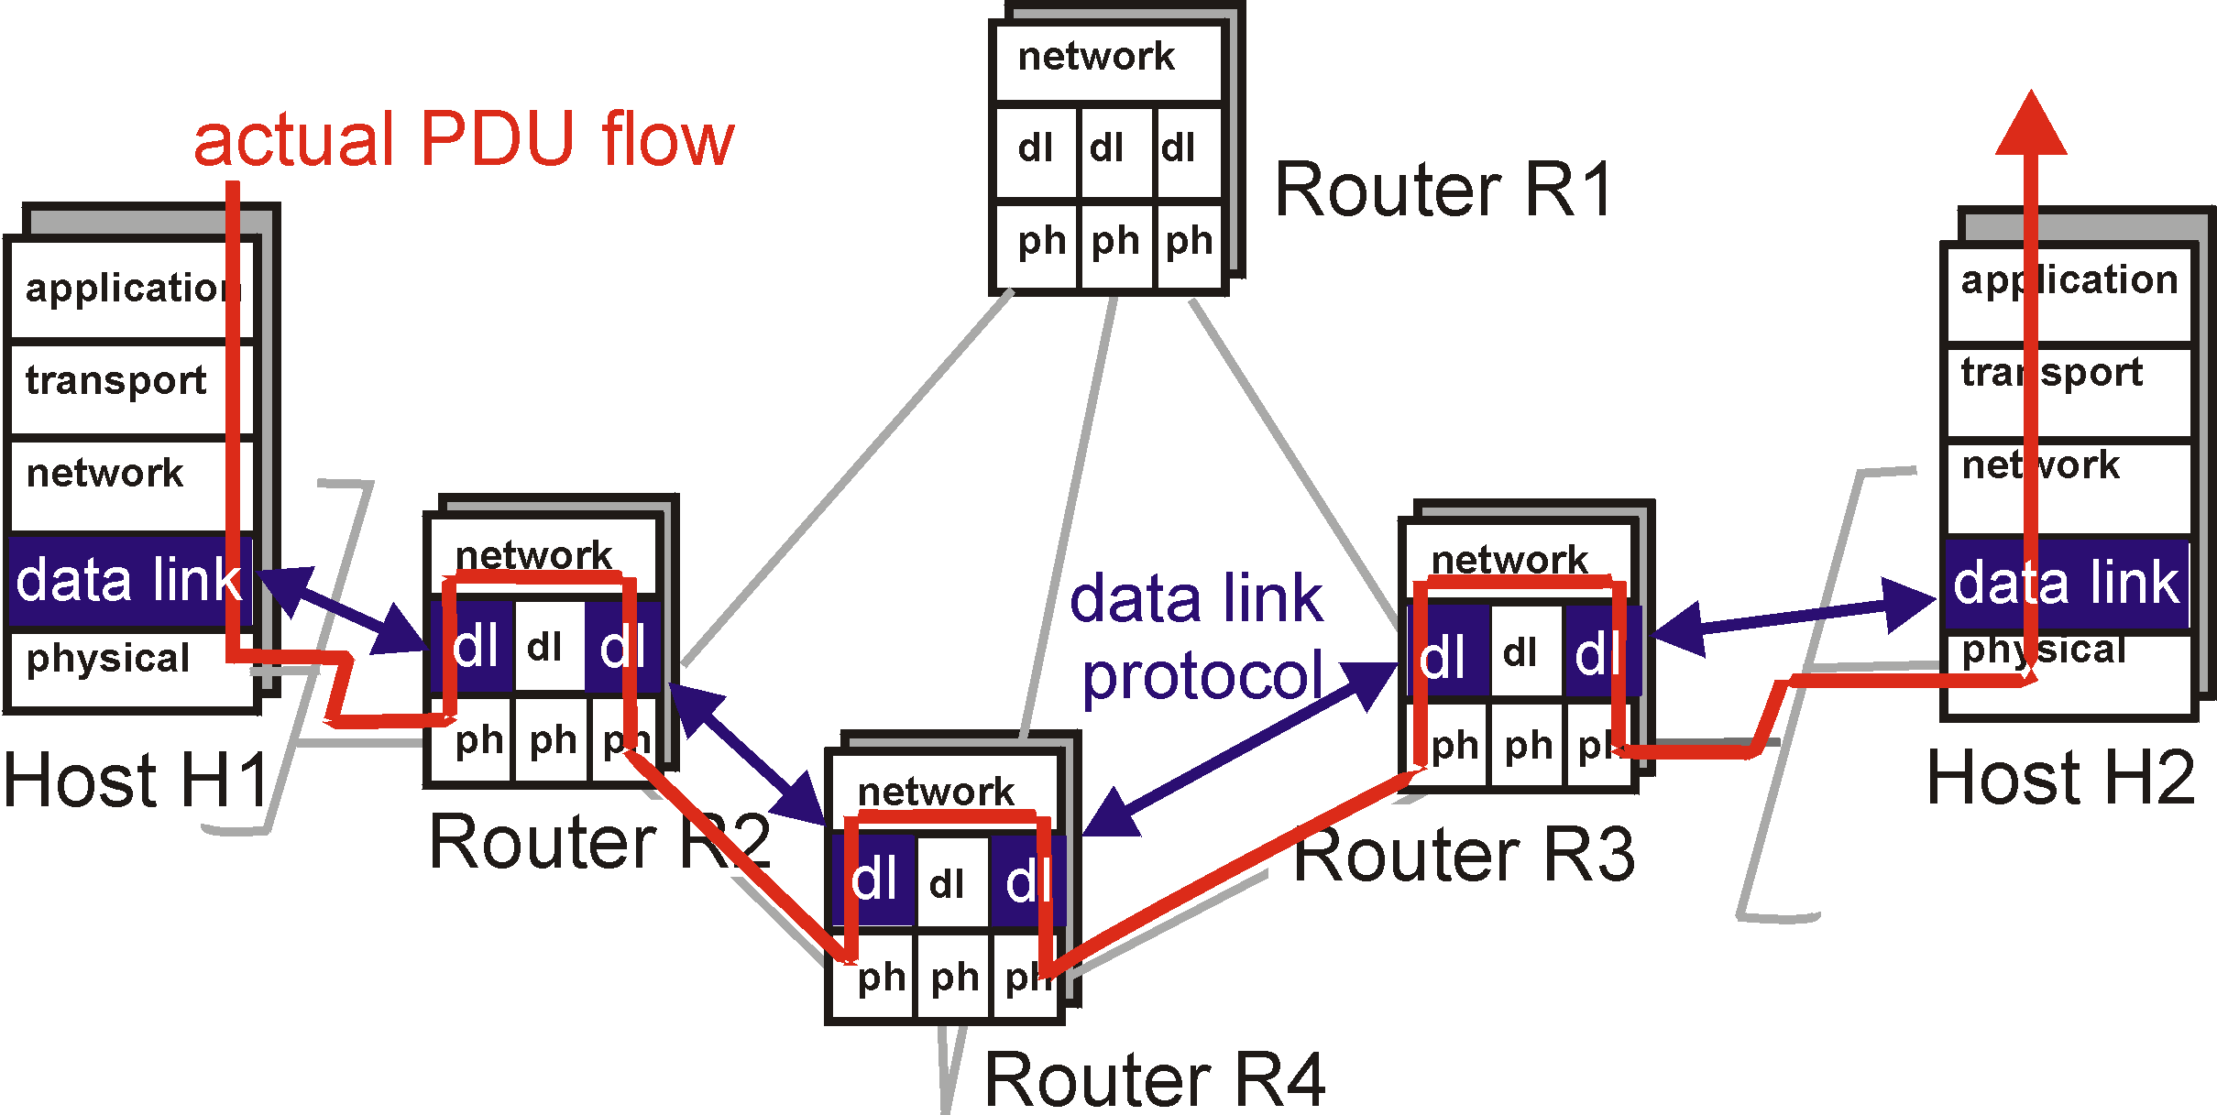
Link Layer: setting the context

Slide 3

Link Layer: setting the context
two physically connected devices:
  host-router, router-router, host-host
unit of data: frame
M
application
transport
network
link
physical
network
link
physical
H
t
M
H
H
M
data link
protocol
n
t
H
H
H
H
H
H
M
l
n
t
M
l
n
t
frame
phys. link
adapter card

Slide 4
Link Layer Services
Framing, link access:
  encapsulate datagram into frame, adding header, trailer
  implement channel access if shared medium,
  ‘physical addresses’ used in frame headers to identify source, dest
    different from IP address!
Reliable delivery between two physically connected devices:
  we learned how to do this already (chapter 3)!
  seldom used on low bit error link (fiber, some twisted pair)
  wireless links: high error rates
    Q: why both link-level and end-end reliability?

Slide 5
Link Layer Services (more)
Flow Control:
  pacing between sender and receivers
Error Detection:
  errors caused by signal attenuation, noise.
  receiver detects presence of errors:
    signals sender for retransmission or drops frame
Error Correction:
  receiver identifies and corrects bit error(s) without resorting to retransmission

Slide 6
Link Layer: Implementation
implemented in “adapter”
  e.g., PCMCIA card, Ethernet card
  typically includes: RAM, DSP chips, host bus interface, and link interface
M
application
transport
network
link
physical
network
link
physical
H
t
M
H
H
M
data link
protocol
n
t
H
H
H
H
H
H
M
l
n
t
M
l
n
t
frame
phys. link
adapter card

Slide 7

Error Detection
EDC= Error Detection and Correction bits (redundancy)
D = Data protected by error checking, may include header fields
Error detection not 100% reliable!
  protocol may miss some errors, but rarely
  larger EDC field yields better detection and correction

Slide 8

Parity Checking
Single Bit Parity:
Detect single bit errors
Two Dimensional Bit Parity:
Detect and correct single bit errors
d data bits parity bit
0111000110101011 1
even or odd parity
0
0

Slide 9
Internet (IP) checksum
Goal: detect “errors” (e.g., flipped bits) in transmitted segment (note: used at transport layer only)
Sender:
treat segment contents as sequence of 16-bit integers
checksum: addition (1’s complement sum) of segment contents
sender puts checksum value into UDP checksum field
Receiver:
compute checksum of received segment
check if computed checksum equals checksum field value:
  NO - error detected
  YES - no error detected. But maybe errors nonethless? More later ….

Slide 10

Checksumming: Cyclic Redundancy Check
based on r+1 bit pattern (generator) G known to tx and rx
treat data bits D as a binary number
obtain r-bit CRC R such that <D,R> divisible (modulo 2) by G
receiver divides <D,R> by G. non-zero remainder implies error
can detect all burst errors less than r+1 bits
widely used in practice (ATM, HDCL)
D.2^{r}
G
R = remainder[ ]

Slide 11

CRC Example
G = 1001 (r=3)
D = 101110
D.2^{r}
G
R = remainder[ ]

Slide 12

Multiple Access Links and Protocols
Three types of “links”:
point-to-point (single wire, e.g. PPP, SLIP)
broadcast (shared wire or medium; e.g, Ethernet, Wavelan, satellite, etc.)
switched (e.g., switched Ethernet, ATM, etc)

Slide 13
Multiple Access Protocols
single shared communication channel
two or more simultaneous transmissions by nodes: interference
  only one node can send successfully at a time
multiple access protocol:
  distributed algorithm that determines how stations share channel, i.e., determine when station can transmit
  communication about channel sharing must use channel itself!
  what to look for in multiple access protocols:
    synchronous or asynchronous
    information needed about other stations
    robustness (e.g., to channel errors)
    performance

Slide 14
MAC Protocols: a taxonomy
Three broad classes:
Static Channel Partitioning
  divide channel into smaller “pieces” (time slots, frequency)
  allocate piece to node for exclusive use
Random Access
  allow collisions
  “recover” from collisions
“Taking turns” (Dynamic channel partitioning)
  tightly coordinate shared access to avoid collisions
Goal: efficient, fair, simple, decentralized

Slide 15

Channel Partitioning MAC protocols: TDMA
TDMA: time division multiple access
access to channel in "rounds"
each station gets fixed length slot (length = pkt trans time) in each round
unused slots go idle
example: 6-station LAN, 1,3,4 have pkt, slots 2,5,6 idle
TDM (Time Division Multiplexing): channel divided into N time slots, one per user; inefficient with low duty cycle users and at light load.
FDM (Frequency Division Multiplexing): frequency subdivided.

Slide 16
Channel Partitioning MAC protocols: FDMA
FDMA: frequency division multiple access
channel spectrum divided into frequency bands
each station assigned fixed frequency band
unused transmission time in frequency bands go idle
example: 6-station LAN, 1,3,4 have pkt, frequency bands 2,5,6 idle
TDM (Time Division Multiplexing): channel divided into N time slots, one per user; inefficient with low duty cycle users and at light load.
FDM (Frequency Division Multiplexing): frequency subdivided.
time
frequency bands

Slide 17
Channel Partitioning (CDMA)
CDMA (Code Division Multiple Access)
unique “code” assigned to each user; ie, code set partitioning
used mostly in wireless broadcast channels (cellular, satellite,etc)
all users share same frequency, but each user has own “chipping” sequence (ie, code) to encode data
encoded signal = (original data) X (chipping sequence)
decoding: inner-product of encoded signal and chipping sequence
allows multiple users to “coexist” and transmit simultaneously with minimal interference (if codes are “orthogonal”)

Slide 18
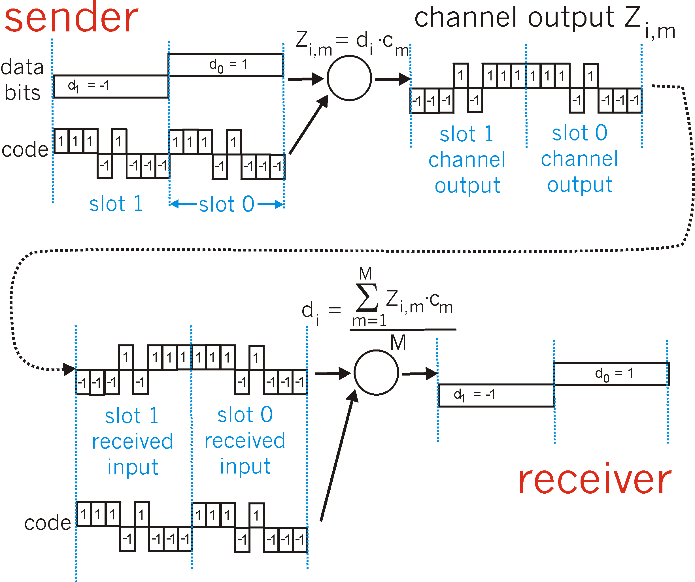
CDMA Encode/Decode

Slide 19

CDMA: two-sender interference
sender 1
sender 2
uses sender 1 code
to receive sender 1 data

Slide 20
Random Access protocols
When node has packet to send
  transmit at full channel data rate R.
  no a priori coordination among nodes
two or more trasnmitting nodes -> “collision”,
random access MAC protocol specifies:
  how to detect collisions
  how to recover from collisions (e.g., via delayed retransmissions)
Examples of random access MAC protocols:
  slotted ALOHA
  ALOHA
  CSMA and CSMA/CD

Slide 21

Slotted Aloha
time is divided into equal size slots (= pkt trans. time)
node with new pkt: transmit at beginning of next slot
if collision: retransmit pkt in future slots with probability p, until successful.
Success (S), Collision (C), Empty (E) slots

Slide 22
Slotted Aloha efficiency
Q: what is max fraction slots successful?
A: Suppose N stations have packets to send
  each transmits in slot with probability p
  probability of successful transmission S is:
by any specific single node: S= p (1-p)^{(N-1)}
by any of N nodes
S = Prob (only one transmits)
= N p (1-p)^{(N-1)}
for optimum p as N -> infty ...
= 1/e = .37
At best: channel
use for useful
transmissions 37%
of time!

Slide 23

Pure (unslotted) ALOHA
unslotted Aloha: simpler, no synchronization
pkt needs transmission:
  send without awaiting for beginning of slot
collision probability increases:
  pkt sent at t₀ collide with other pkts sent in [t₀-1, t₀+1]

Slide 24
Pure Aloha (cont.)
P(success by given node) = P(node transmits) .
P(no other node transmits in [t₀-1,t₀] .
P(no other node transmits in [t₀,t₀ +1]
= p . (1-p)^{(N-1)} (1-p)^{(N-1)}
P(success by any of N nodes) = N p . (1-p)^{(N-1)} (1-p)^{(N-1)}
… choosing optimum p as n -> infty ...
^{= 1/(2e) = .18}
0.4
0.3
S = throughput = “goodput”
(success rate)
protocol constrains
effective channel
throughput!
Slotted Aloha
0.2
0.1
Pure Aloha
0.5
1.0
1.5
2.0
G = offered load = Np

Slide 25
CSMA: Carrier Sense Multiple Access)
CSMA: listen before transmit:
If channel sensed idle: transmit entire pkt
If channel sensed busy, defer transmission
  Persistent CSMA: retry immediately with probability p when channel becomes idle (may cause instability)
  Non-persistent CSMA: retry after random interval
human analogy: don’t interrupt others!

Slide 26

CSMA collisions
spatial layout of nodes along ethernet
collisions can occur:
propagation delay means
two nodes may not year
hear each other’s transmission
collision:
entire packet transmission
time wasted
note:
role of distance and propagation delay in determining collision prob.

Slide 27
CSMA/CD (Collision Detection)
CSMA/CD: carrier sensing, deferral as in CSMA
  collisions detected within short time
  colliding transmissions aborted, reducing channel wastage
  persistent or non-persistent retransmission
collision detection:
  easy in wired LANs: measure signal strengths, compare transmitted, received signals
  difficult in wireless LANs: receiver shut off while transmitting
human analogy: the polite conversationalist

Slide 28

CSMA/CD collision detection

Slide 29
“Taking Turns” MAC protocols
channel partitioning MAC protocols:
  share channel efficiently at high uniform load
  inefficient at low load: delay in channel access, 1/N bandwidth allocated even if only 1 active node!
Random access MAC protocols
  efficient at low load: single node can fully utilize channel
  high load: collision overhead
“taking turns” protocols
  look for best of both worlds!

Slide 30
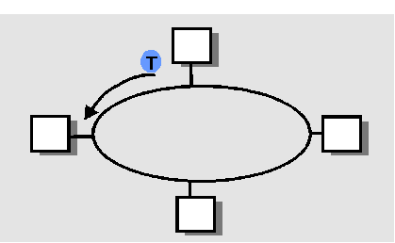
“Taking Turns” MAC protocols
Polling:
master node “invites” slave nodes to transmit in turn
Request to Send, Clear to Send msgs
concerns:
  polling overhead
  latency
  single point of failure (master)
Token passing:
control token passed from one node to next sequentially.
token message
concerns:
  token overhead
  latency
  single point of failure (token)

Slide 31
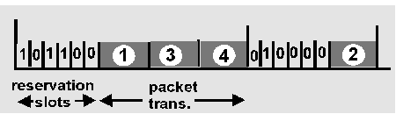
Reservation-based protocols
Distributed Polling:
time divided into slots
begins with N short reservation slots
  reservation slot time equal to channel end-end propagation delay
  station with message to send posts reservation
  reservation seen by all stations
after reservation slots, message transmissions ordered by known priority

